Slide 1
Lecture 5: Regularization

Slide 2
Lecture Outline
Overfitting
Applications of Model Selection
Behind Ordinary Least Squares, AIC, BIC
Bias vs Variance
Regularization: LASSO and Ridge
Regularization Methods: A Comparison

Slide 3
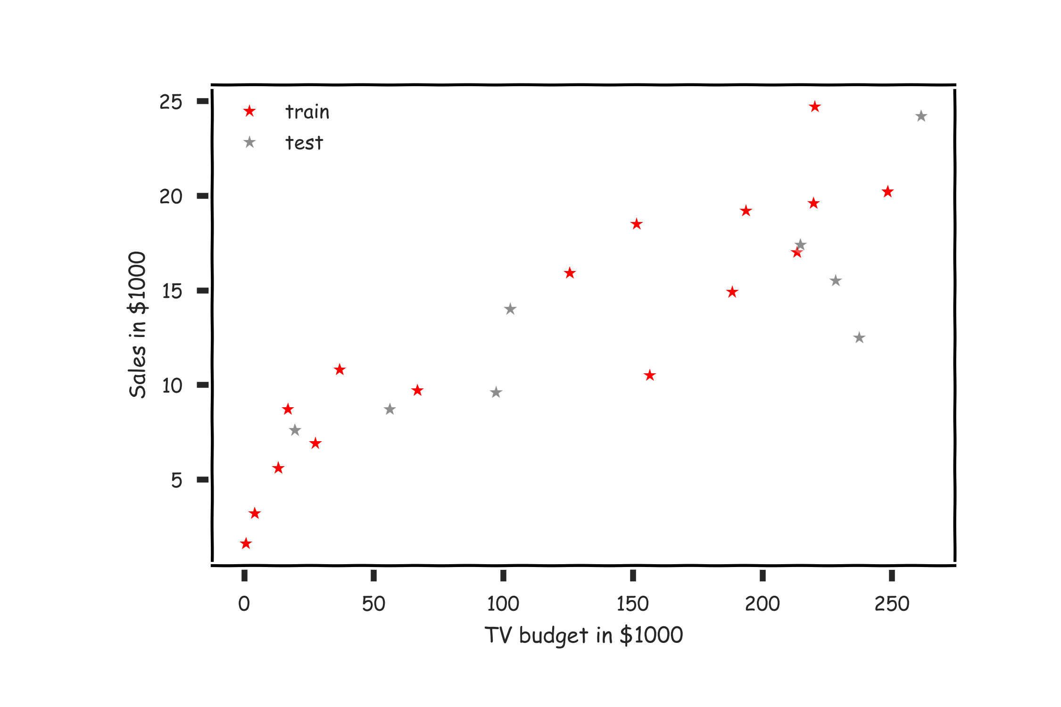
Overfitting

Slide 4
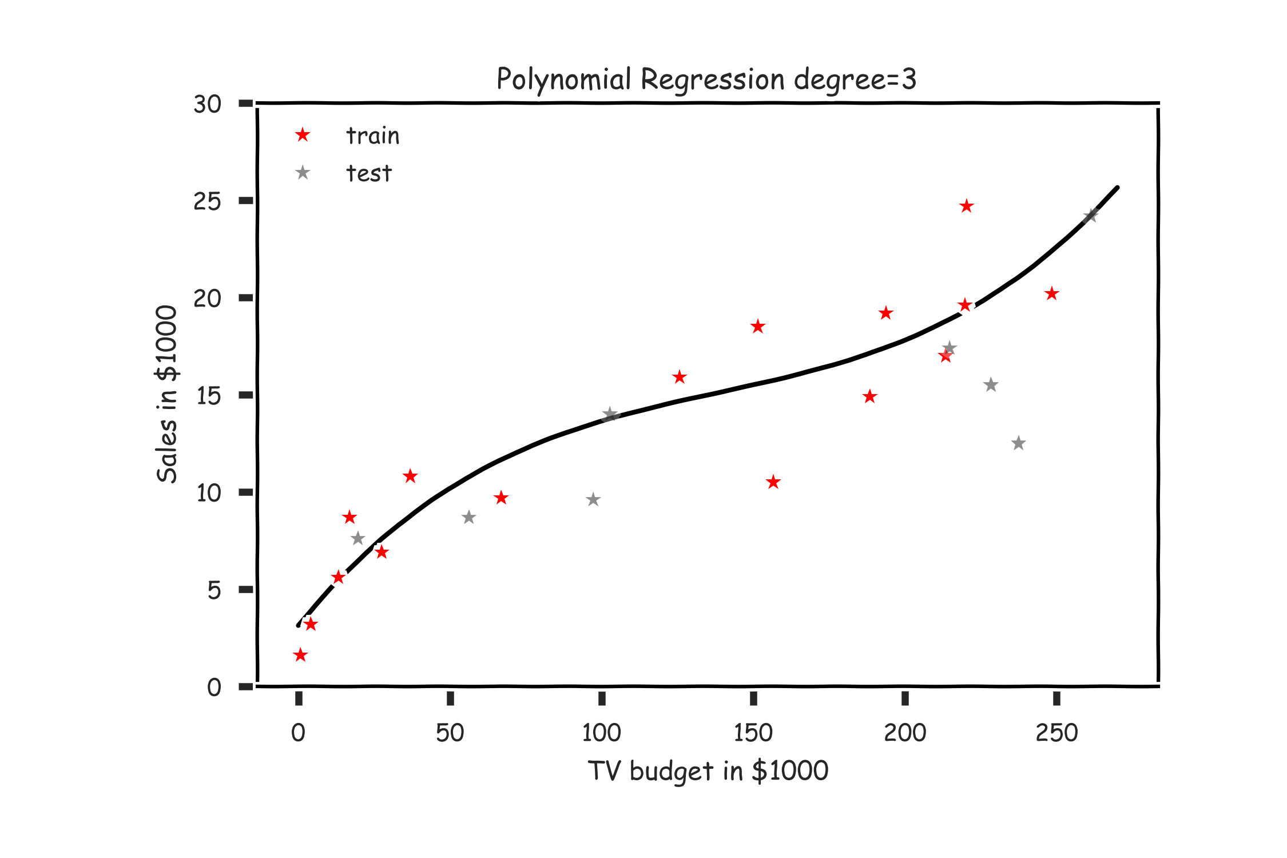
Overfitting

Slide 5
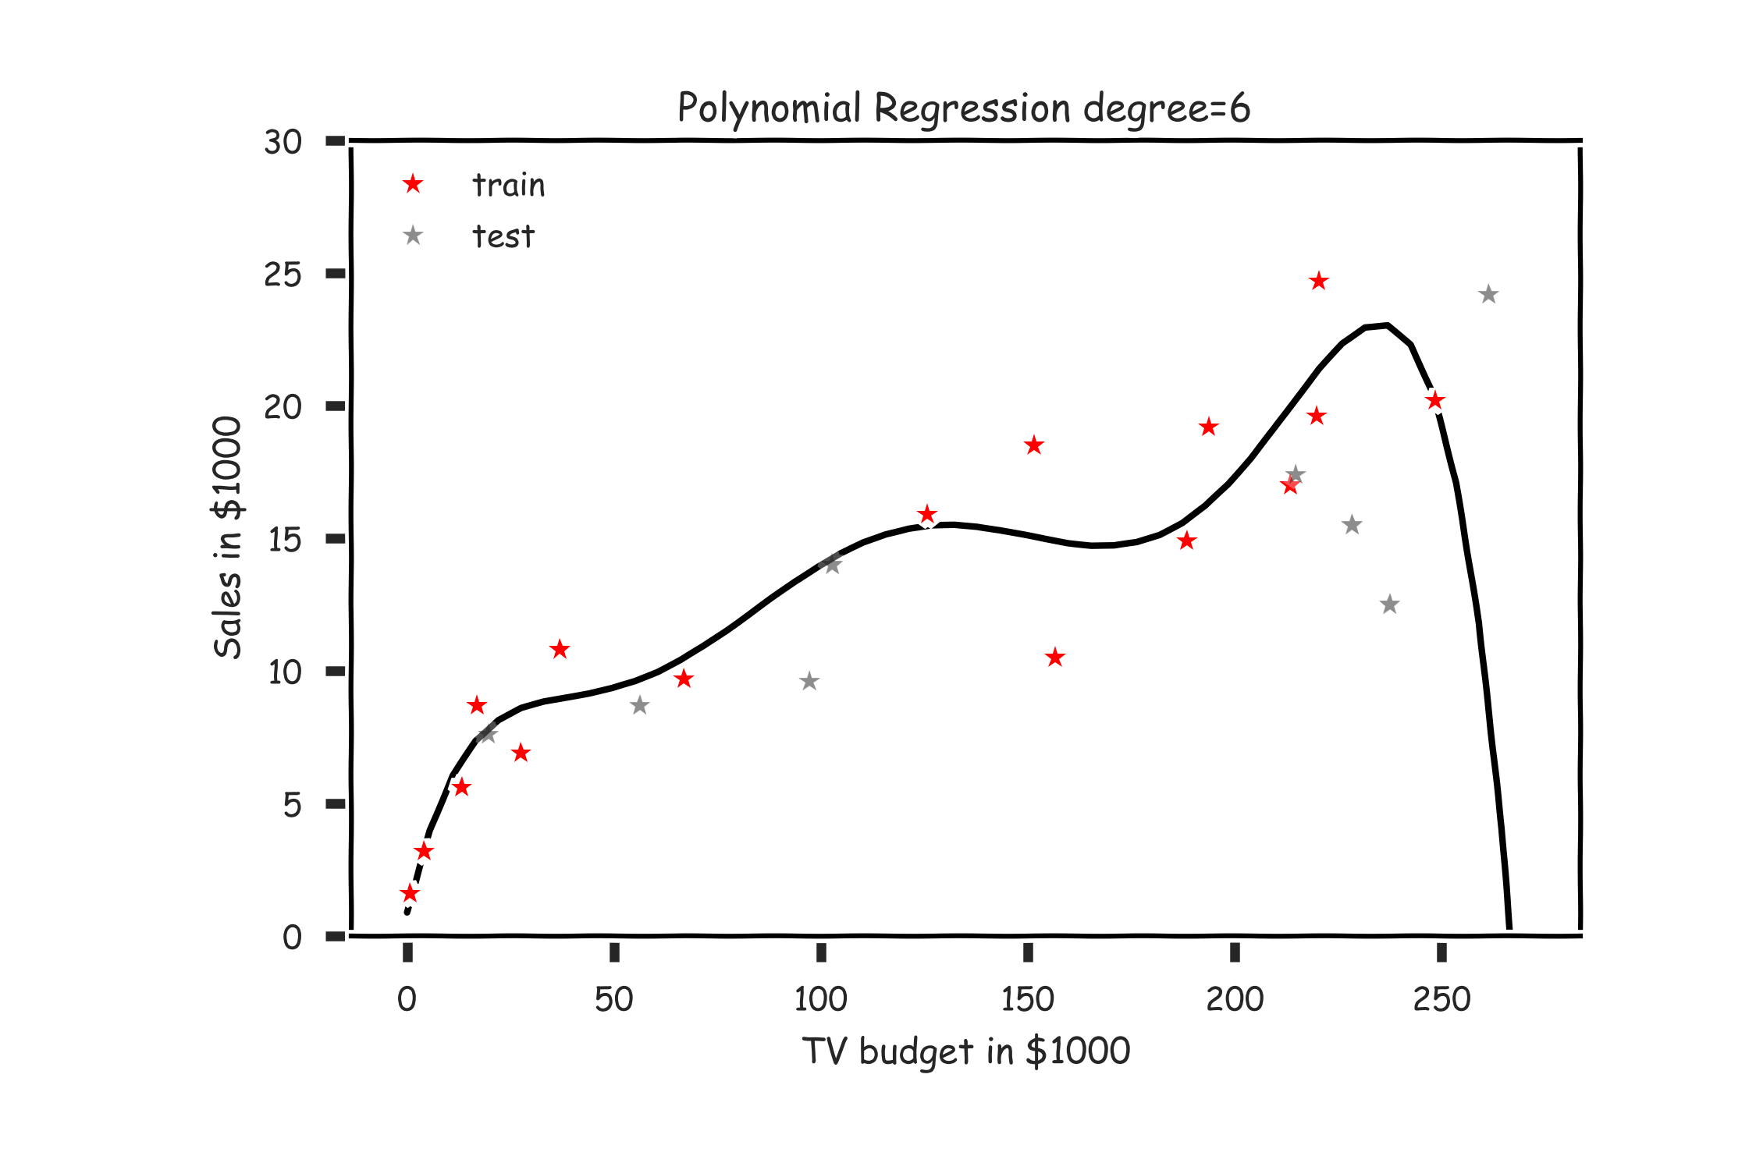
Overfitting

Slide 6
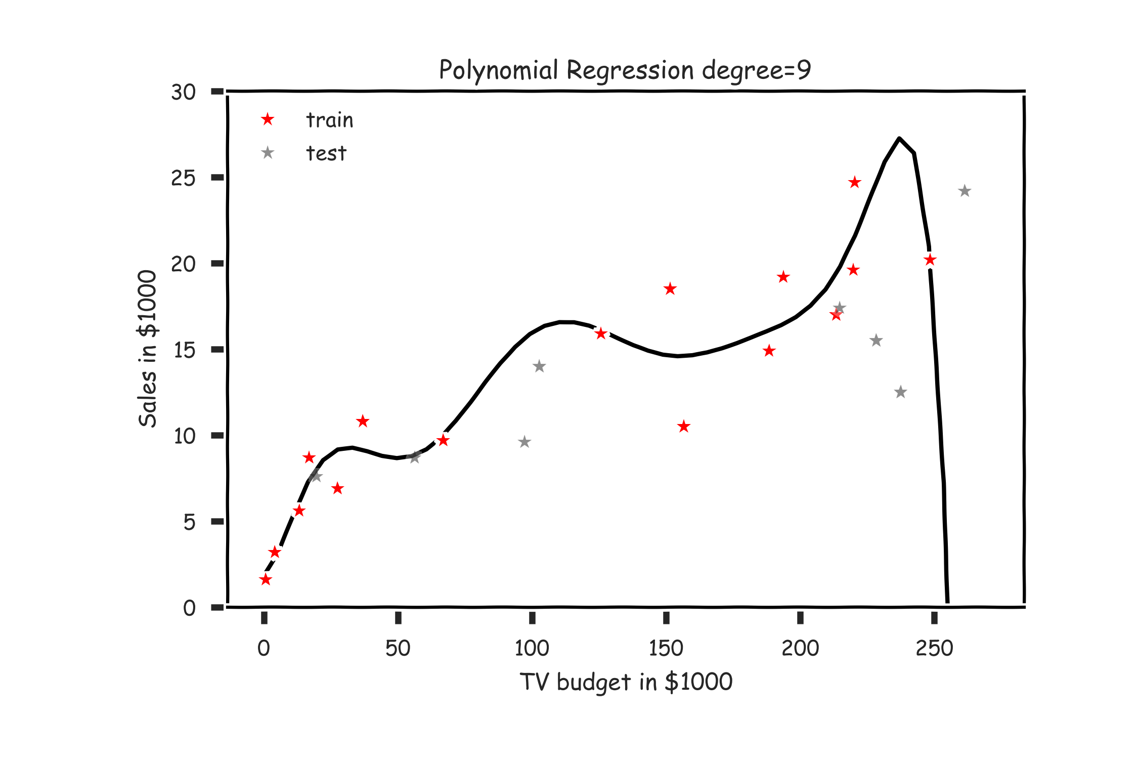
Overfitting

Slide 7
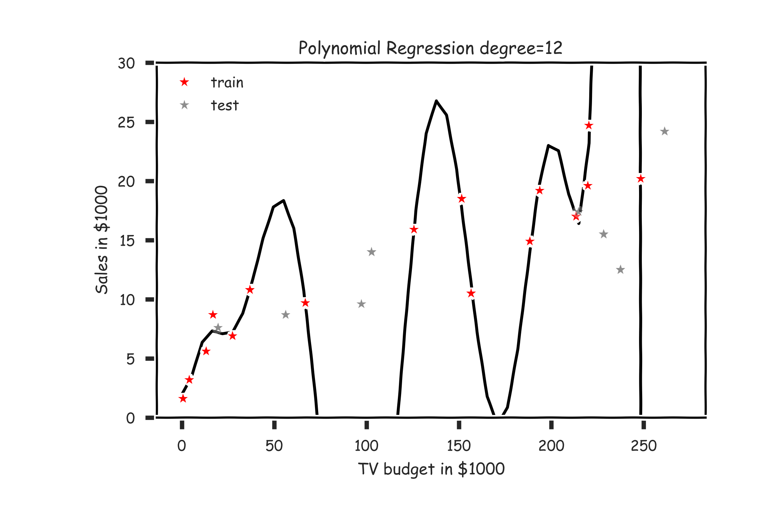
Overfitting

Slide 8
Model Selection
Model selection is the application of a principled method to determine the complexity of the model, e.g. choosing a subset of predictors, choosing the degree of the polynomial model etc.
A strong motivation for performing model selection is to avoid overfitting, which we saw can happen when:
there are too many predictors:
the feature space has high dimensionality
the polynomial degree is too high
too many cross terms are considered
the coefficients values are too extreme

Slide 9
Stepwise Variable Selection and Cross Validation
Last time, we addressed the issue of selecting optimal subsets of predictors (including choosing the degree of polynomial models) through:
stepwise variable selection - iteratively building an optimal subset of predictors by optimizing a fixed model evaluation metric each time,
cross validation - selecting an optimal model by evaluating each model on multiple validation sets.
Today, we will also address the issue of discouraging extreme values in model parameters

Slide 10
Stepwise Variable Selection Computational Complexity
How many models did we evaluate?
1st step, J Models
2nd step, J-1 Models (add 1 predictor out of J-1 possible)
3rd step, J-2 Models (add 1 predictor out of J-2 possible)
…

Slide 11
Cross Validation (revisited)

Slide 12
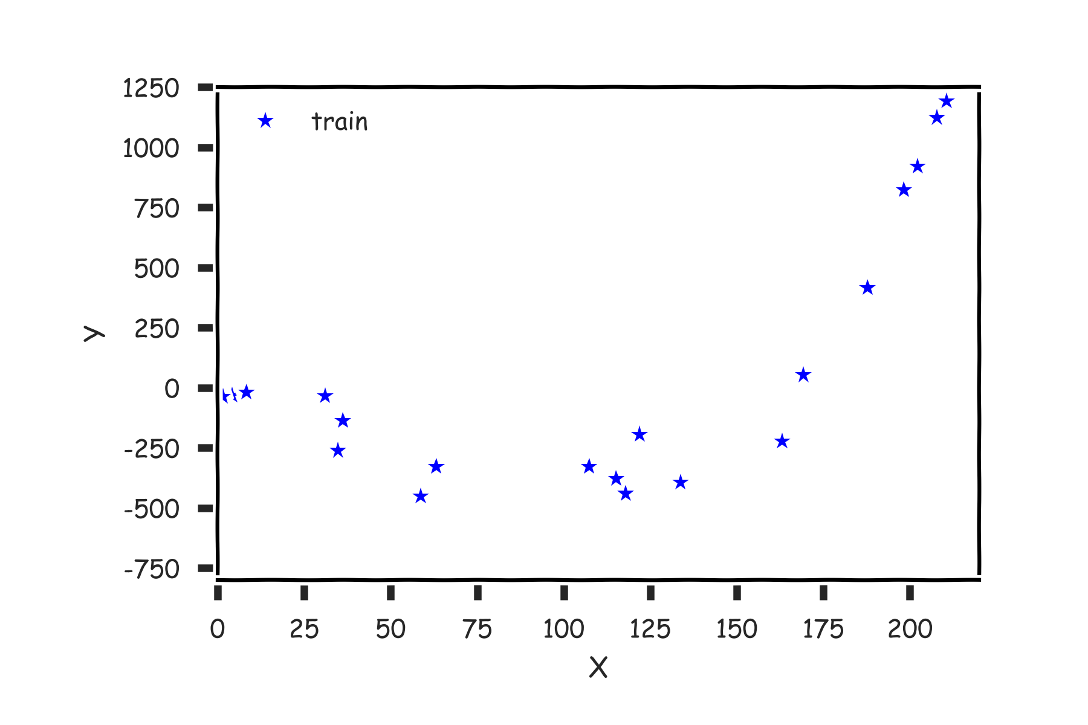
Cross Validation

Slide 13
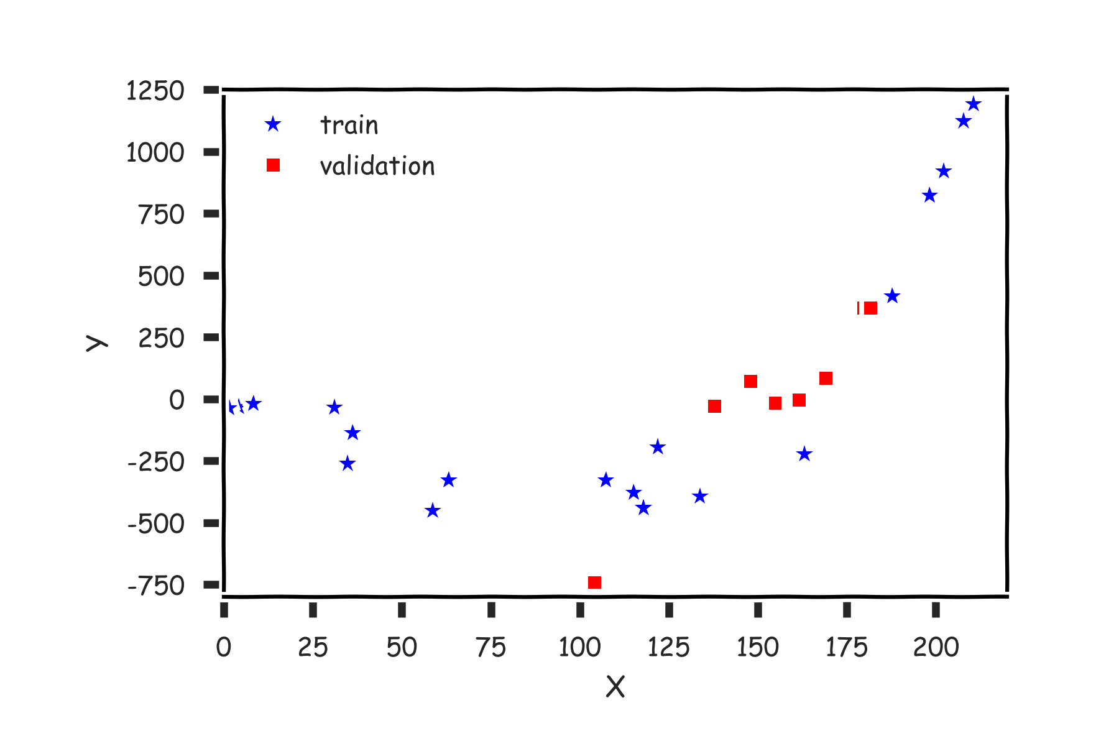
Cross Validation

Slide 14
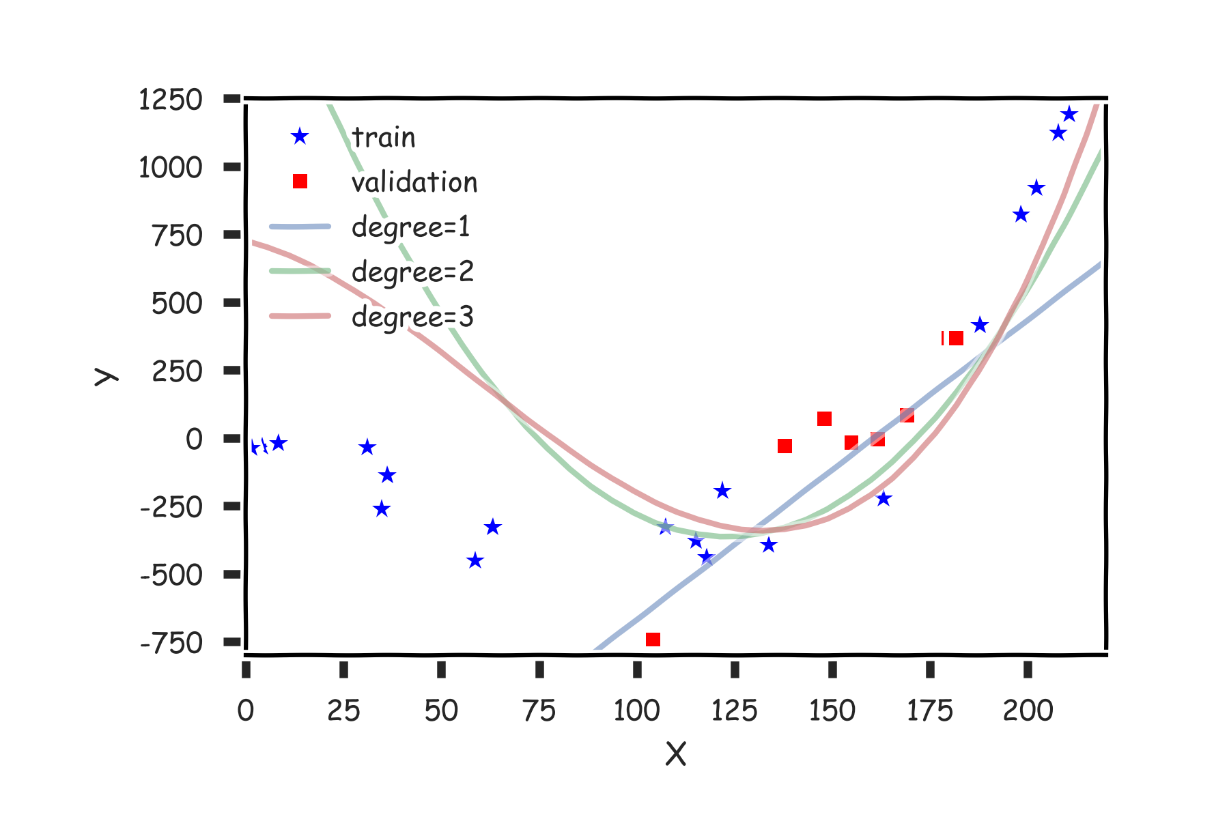
Cross Validation

Slide 15
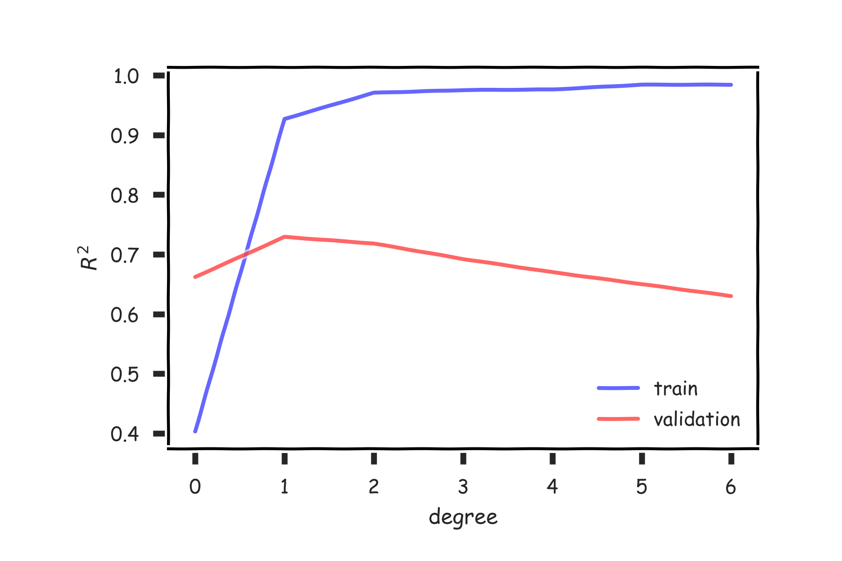
Cross Validation

Slide 16
Cross Validation
Last lecture we have discussed, Leave-One-Out and K-fold Cross Validation.
Question: What is the right ratio of train/validate/test, how do I choose K?

Slide 17
Predictor Selection: Cross Validation
Rather than choosing a subset of significant predictors using stepwise selection with train/validation method, we can use K-fold cross validation:
create a collection of different subsets of the predictors for each subset of predictors, compute the cross
validation score for the model created using only that subset
select the subset (and the corresponding model) with the best cross validation score
evaluate the model one last time on the test set
Question: What is the difference in multiple predictors and polynomial regression in model selection?

Slide 18
Predictor Selection: Cross Validation
We can frame the problem of degree selection for polynomial models as a predictor selection problem: which of the predictors
should we select for modeling?
We can apply stepwise selection to determine the optimal subset of predictors.

Slide 19
Degree Selection: Cross Validation
We can also select the degree of a polynomial model using K-fold cross validation sequentially.
consider a number of different degrees for each degree, compute the cross validation score for a polynomial model of that degree
select the degree, and the corresponding model with the best cross validation score
evaluate the model one last time on the test set.

Slide 20

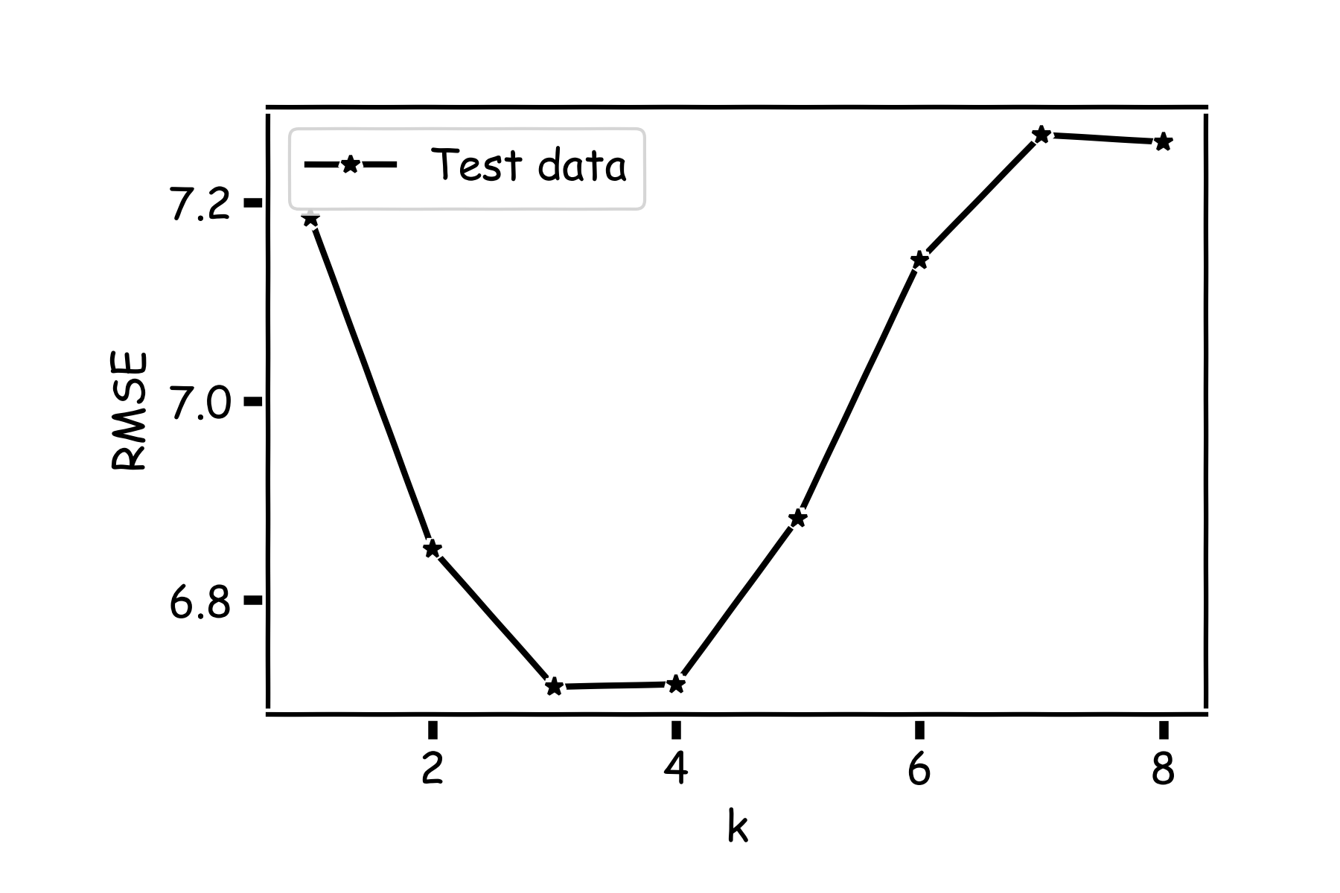
kNN Revisited

Slide 21
kNN Revisited
Recall our first simple, intuitive, non-parametric model for regression - the kNN model. We saw that it is vitally important to select an appropriate k for the data.
If the k is too small then the model is very sensitive to noise (since a new prediction is based on very few observed neighbors), and if the k is too large, the model tends towards making constant predictions.
A principled way to choose k is through K-fold cross validation.

Slide 22
Without CV
In many scenarios, data are not abundant and therefor CV may not be feasible.
What if we do not have enough data to do CV?

Slide 23
Behind Ordinary Lease Squares, AIC, BIC

Slide 24
AIC and BIC
We’ve mentioned using AIC/BIC to evaluate the explanatory powers of models. The following formulae can be used to calculate these criteria:
where J is the number of predictors in model.
Intuitively, AIC/BIC is a loss function that depends both on the predictive error, RSS, and the complexity of the model. We see that we prefer a model with few parameters and low RSS.
But why do the formulae look this way - what is the justification?

Slide 25
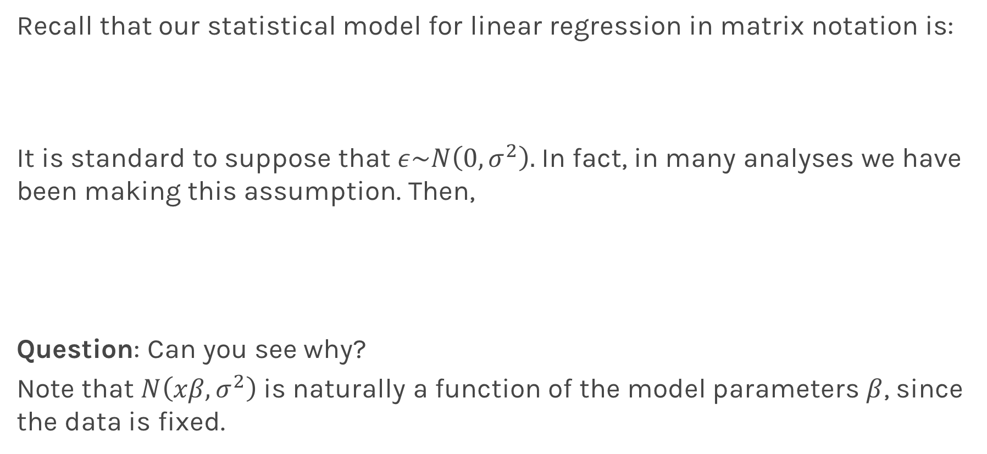
Likelihood Functions
Recall that our statistical model for linear regression in matrix notation is:
It is standard to suppose that $ε\sim N\left(0,σ^{2}\right).$In fact, in many analyses we have been making this assumption. Then,
Question: Can you see why?
Note that $N\left(xβ,σ^{2}\right)$ is naturally a function of the model parameters $β$, since the data is fixed.

Slide 26
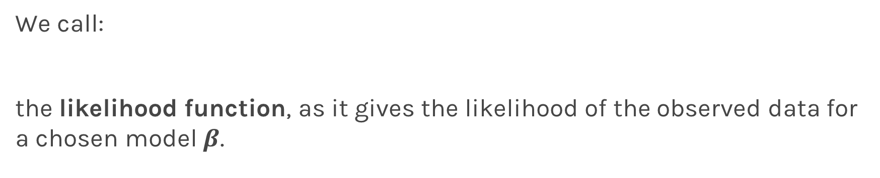
Likelihood Functions
We call:
the likelihood function, as it gives the likelihood of the observed data for a chosen model $β$.

Slide 27
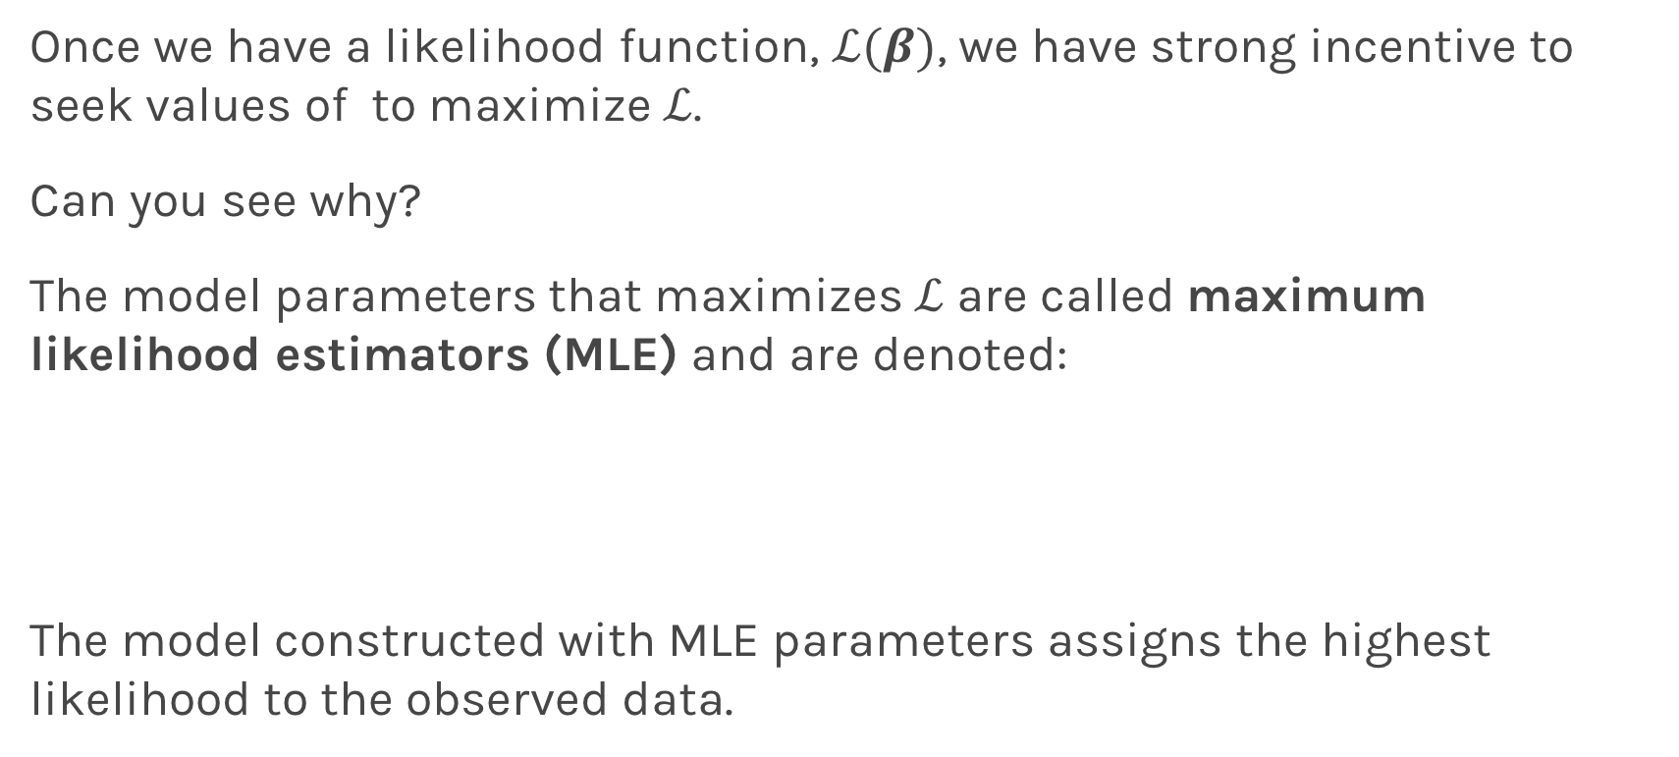
Maximum Likelihood Estimators
Once we have a likelihood function, $ℒ(β)$, we have strong incentive to seek values of to maximize $ℒ$.
Can you see why?
The model parameters that maximizes $ℒ$ are called maximum likelihood estimators (MLE) and are denoted:
The model constructed with MLE parameters assigns the highest likelihood to the observed data.

Slide 28
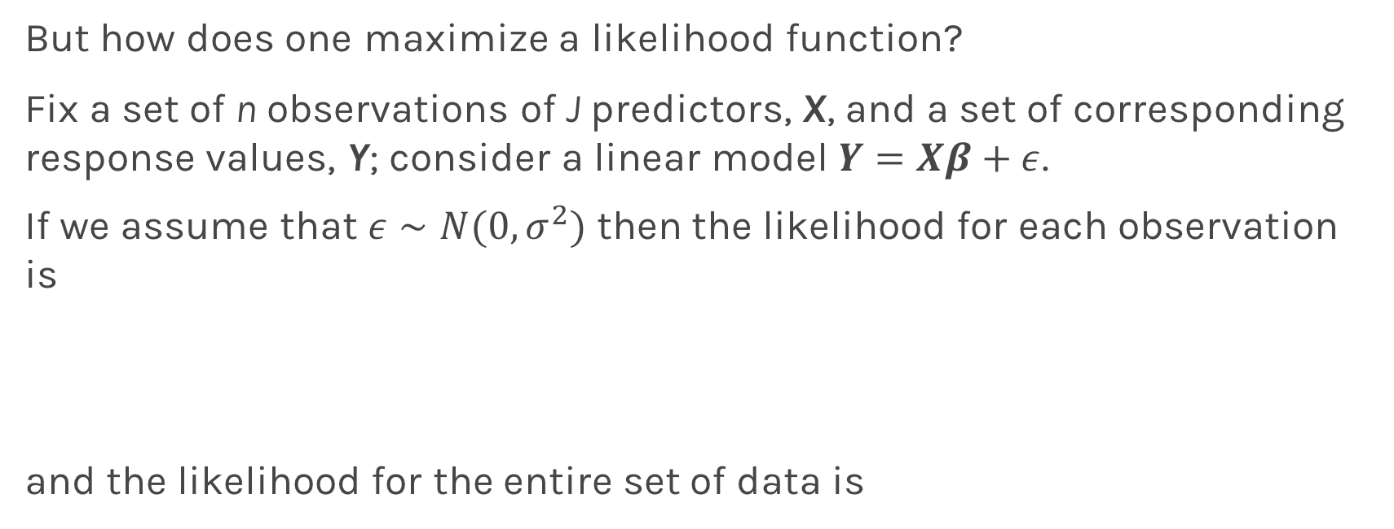
Maximum Likelihood Estimators
But how does one maximize a likelihood function?
Fix a set of n observations of J predictors, X, and a set of corresponding response values, Y; consider a linear model $Y=Xβ+ε$.
If we assume that $ε∼Ν(0,σ^{2})$ then the likelihood for each observation is
and the likelihood for the entire set of data is

Slide 29
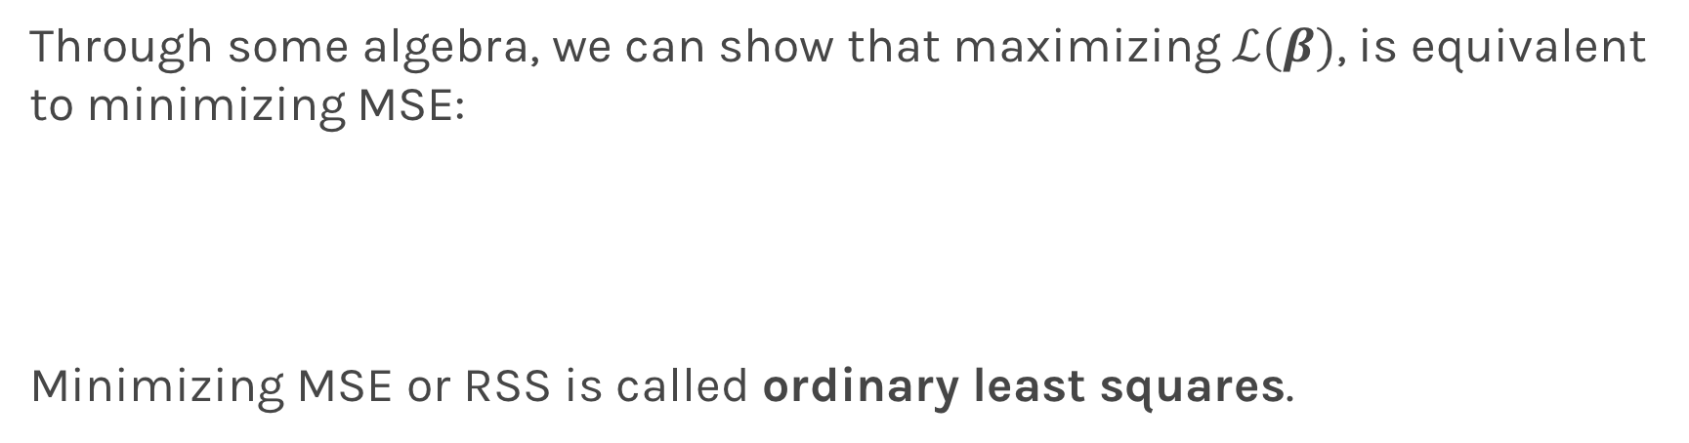
Maximum Likelihood Estimators
Through some algebra, we can show that maximizing $ℒ(β)$, is equivalent to minimizing MSE:
Minimizing MSE or RSS is called ordinary least squares.

Slide 30
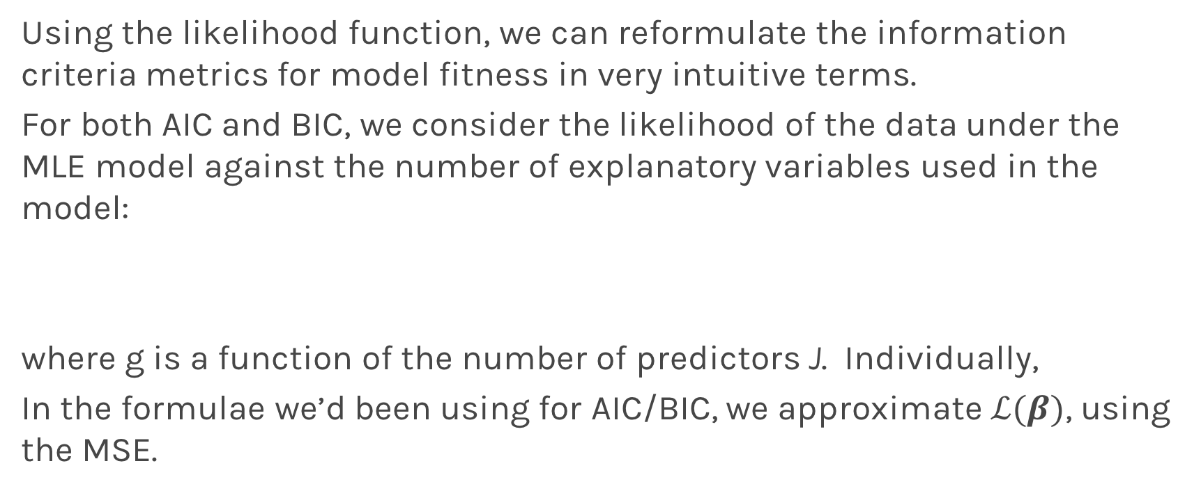
Information Criteria Revisited
Using the likelihood function, we can reformulate the information criteria metrics for model fitness in very intuitive terms.
For both AIC and BIC, we consider the likelihood of the data under the MLE model against the number of explanatory variables used in the model:
where g is a function of the number of predictors J. Individually,
In the formulae we’d been using for AIC/BIC, we approximate $ℒ(β)$, using the MSE.

Slide 31
Bias vs Variance

Slide 34
Bias vs Variance
Left: 200 best fit straight lines, each a fit on a different 30 point training sets from a 200 point population.
Right: Best-fit models using degree 20 polynomial

Slide 35
Bias vs Variance
Left: Linear regression coefficients
Right: Poly regression of order 20 coefficients

Slide 36
Variance

Slide 37
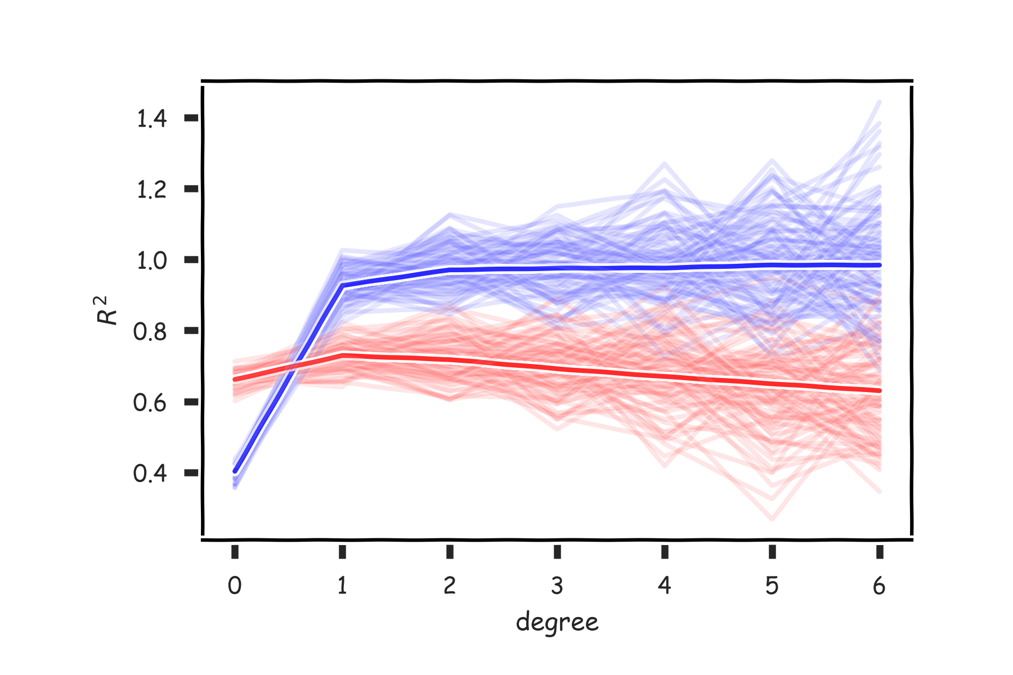
Variance

Slide 38
Regularization: LASSO and Ridge

Slide 39
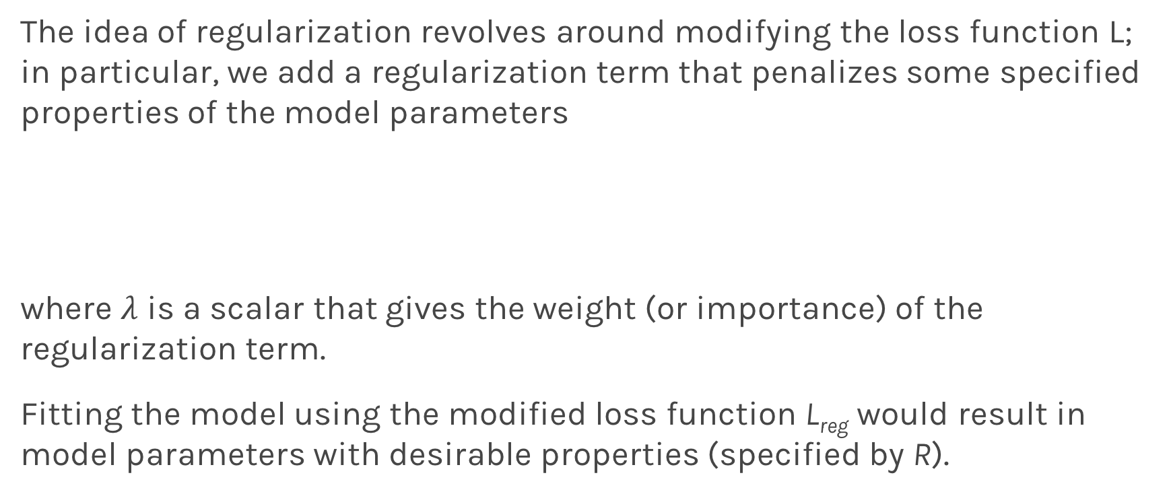
Regularization: An Overview
The idea of regularization revolves around modifying the loss function L; in particular, we add a regularization term that penalizes some specified properties of the model parameters
where $λ$ is a scalar that gives the weight (or importance) of the regularization term.
Fitting the model using the modified loss function L_{reg} would result in model parameters with desirable properties (specified by R).

Slide 40
LASSO Regression
Since we wish to discourage extreme values in model parameter, we need to choose a regularization term that penalizes parameter magnitudes. For our loss function, we will again use MSE.
Together our regularized loss function is:
Note that is the l₁ norm of the vector β

Slide 41
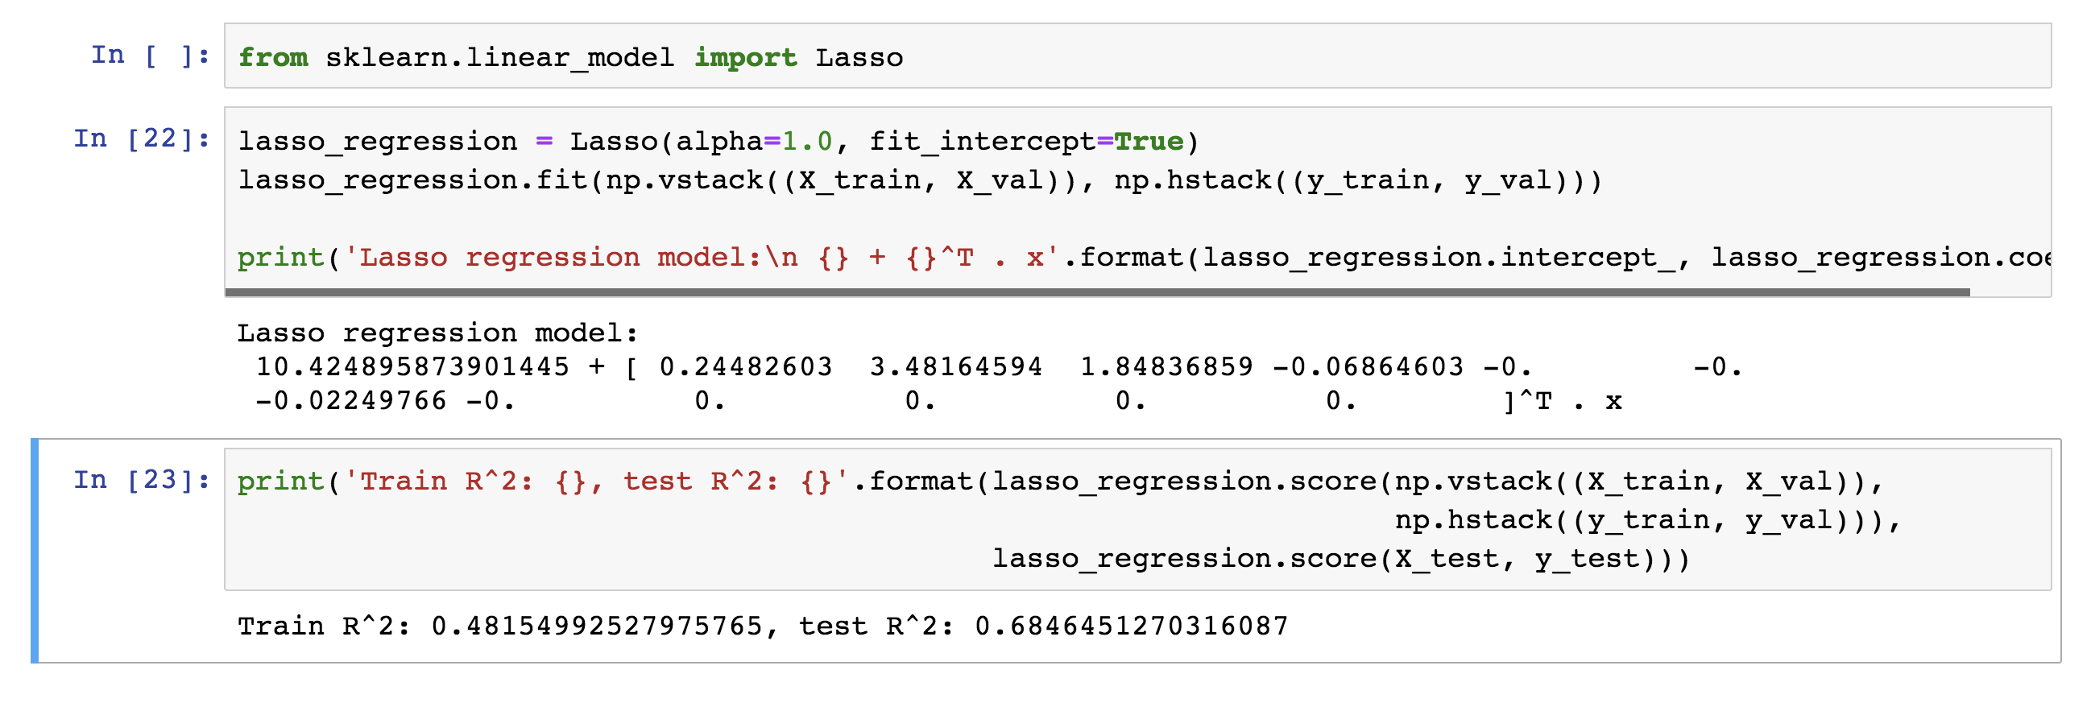
LASSO Regression
Hence, we often say that L_{LASSO} is the loss function for l₁ regularization.
Finding the model parameters β_{LASSO} that minimize the l₁ regularized loss function is called LASSO regression.

Slide 42
Ridge Regression
Alternatively, we can choose a regularization term that penalizes the squares of the parameter magnitudes. Then, our regularized loss function is:
Note that is the l₂ norm of the vector β

Slide 43
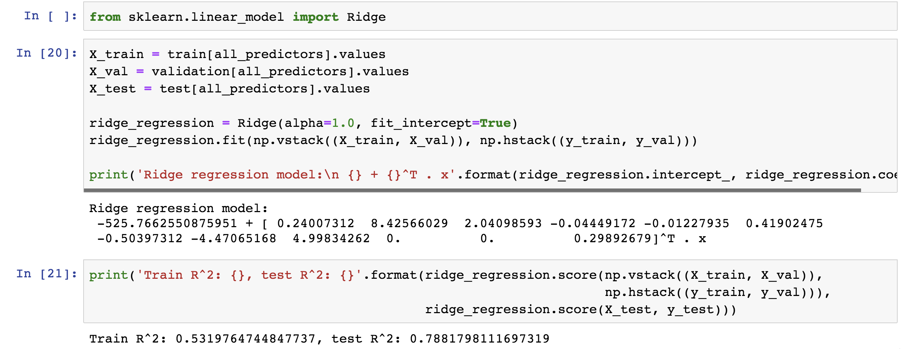
Ridge Regression
Hence, we often say that L_{ridge} is the loss function for l₂ regularization.
Finding the model parameters β_{ridge} that minimize the l₂ regularized loss function is called ridge regression.

Slide 44
Choosing λ
In both ridge and LASSO regression, we see that the larger our choice of the regularization parameter λ, the more heavily we penalize large values in β,
If λ is close to zero, we recover the MSE, i.e. ridge and LASSO regression is just ordinary regression.
If λ is sufficiently large, the MSE term in the regularized loss function will be insignificant and the regularization term will force β_{ridge} and β_{LASSO} to be close to zero.
To avoid ad-hoc choices, we should select λ using cross-validation.

Slide 45
Ridge - Computational complexity
Solution to ridge regression:
The solution of the Ridge/Lasso regression involves three steps
Select λ
Find the minimum of the ridge/Lasso regression cost function (using linear algebra) as with the multiple regression and record the R² on the test set.
Find the λ that gives the largest R²

Slide 46
The Geometry of Regularization

Slide 47
Variable Selection as Regularization
Since LASSO regression tend to produce zero estimates for a number of model parameters - we say that LASSO solutions are sparse - we consider LASSO to be a method for variable selection.
Many prefer using LASSO for variable selection (as well as for suppressing extreme parameter values) rather than stepwise selection, as LASSO avoids the statistic problems that arises in stepwise selection.
Question: What are the pros and cons of the two approaches?

Slide 48
Bibliography
Bolelli, L., Ertekin, S., and Giles, C. L. Topic and trend detection in text collections using latent dirichlet allocation. In European Conference on Information Retrieval (2009), Springer, pp. 776-780.
Chen, W., Wang, Y., and Yang, S. Efficient influence maximization in social networks. In Proceedings of the 15th ACM SIGKDD international conference on Knowledge discovery and data mining (2009), ACM, pp. 199-208.
Chong, W., Blei, D., and Li, F.-F. Simultaneous image classification and annotation. In Computer Vision and Pattern Recognition, 2009. CVPR 2009. IEEE Conference on (2009), IEEE, pp. 1903-1910.
Du, L., Ren, L., Carin, L., and Dunson, D. B. A bayesian model for simultaneous image clustering, annotation and object segmentation. In Advances in neural information processing systems (2009), pp. 486-494.
Elango, P. K., and Jayaraman, K. Clustering images using the latent dirichlet allocation model.
Feng, Y., and Lapata, M. Topic models for image annotation and text illustration. In Human Language Technologies: The 2010 Annual Conference of the North American Chapter of the Association for Computational Linguistics (2010), Association for Computational Linguistics, pp. 831-839.
Hannah, L. A., and Wallach, H. M. Summarizing topics: From word lists to phrases.
Lu, R., and Yang, Q. Trend analysis of news topics on twitter. International Journal of Machine Learning and Computing 2, 3 (2012), 327.

